Slide 1

Gun Violence in the U.S.
US gun violence incidents from 2014-2017

Slide 2
Our Data
We discovered our data from kaggle. The source of this data was downloaded from gunviolencearchive.org.
From the organization's description:
> Gun Violence Archive (GVA) is a not for profit corporation formed in 2013 to provide free online public access to accurate information about gun-related violence in the United States. GVA will collect and check for accuracy, comprehensive information about gun-related violence in the U.S. and then post and disseminate it online.
How did was the data compiled?
Because GVA limits the number of incidents that are returned from a single query, and because the website's "Export to CSV" functionality was missing crucial fields, it was necessary to obtain this dataset using web scraping techniques.
Stage 1: For each date between 1/1/2013 and 3/31/2018, a Python script queried all incidents that happened at that particular date, then scraped the data and wrote it to a CSV file. Each month got its own CSV file, with the exception of 2013, since not many incidents were recorded from then.
Stage 2: Each entry was augmented with additional data not directly viewable from the query results page, such as participant information, geolocation data, etc.
Stage 3: The entries were sorted in order of increasing date, then merged into a single CSV file.

Slide 3
Project Objectives
Clean our dataset to look at 2014-2017 full year data
Our “asks” of the data:
Have incidents of Gun Violence increased, decreased, or were flat in this time period?
What States and Cities have shown highest occurrences of gun violence, both total and adjusted per capita?
Does lack of legislation correlate to an increase in gun violence geographically?
Geographically, do areas with higher gun ownership rates correlate to increased occurrences of gun violence?
Geographically, do areas with that are more favorable towards the gun industry correlate to increased occurrences of gun violence?

Slide 4
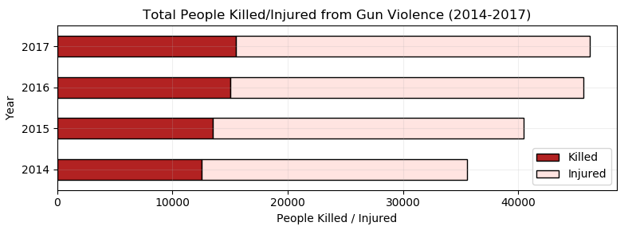
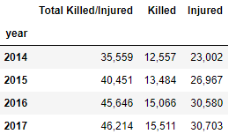
Gun Violence Occurrences 2014-2017
From 2014 to 2017 there were 167,870 total occurrences of gun violence
2017 shows a 29.96% increase in occurrences of gun violence compared to 2014
People killed by gun violence has increased 23.5% during this timeframe
People injured by gun violence has increased 33.5% during this timeframe

Slide 5
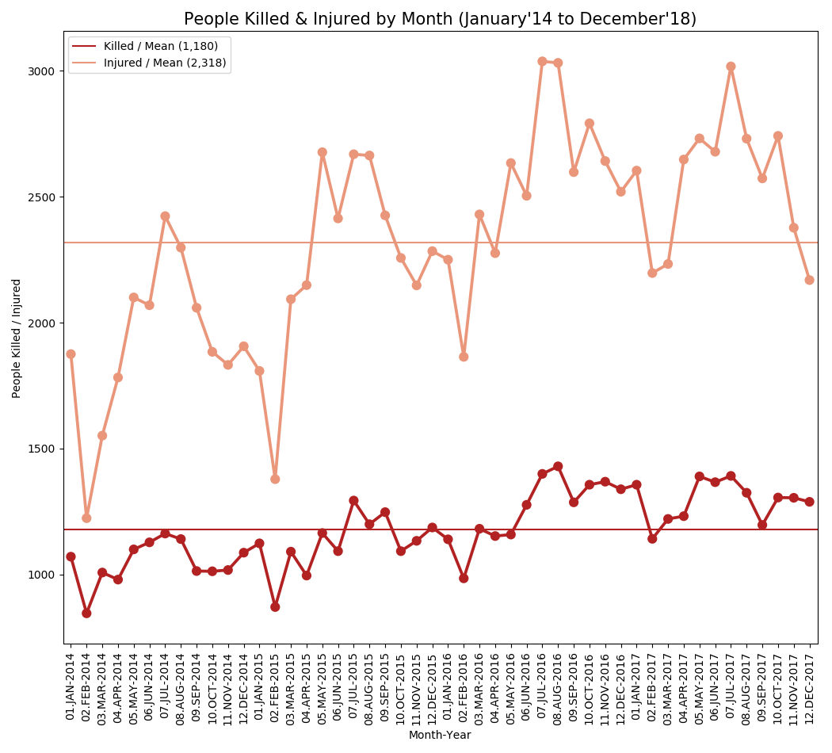
Occurrences of Gun Violence by month Jan’14 to Dec’17 in the U.S. saw:
1,180 people killed per month
2,318 people injured per month

Slide 6
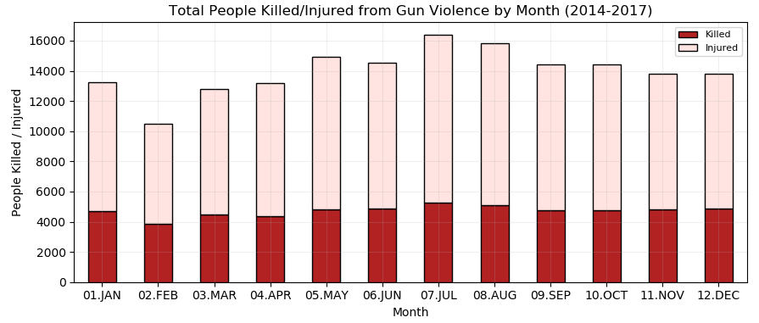
Top months that have the highest occurrences of Gun Violence: July (9.77%), Aug (9.42%), and May (8.91%)
Top months that have the highest occurrences of people killed: July (9.26%), Aug (8.99%), and Dec (8.65%)
Top months that have the highest occurrences of people injured: July (10.02%), Aug (9.64%), and May (9.12%)

Slide 7
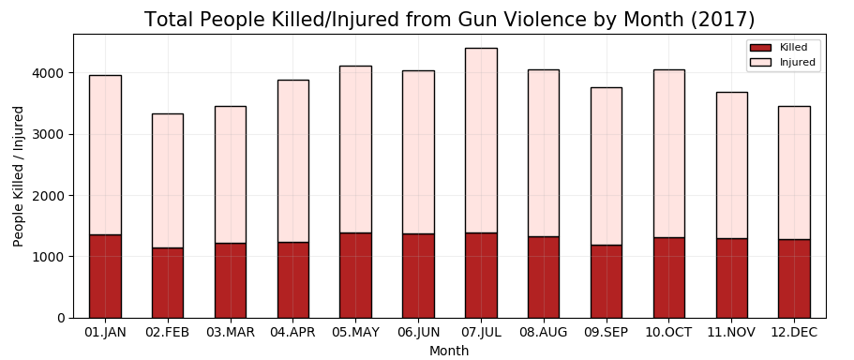
Isolating the last full year in our dataset, we see a very similar trend by month as we saw in the full data set
July is still the highest month for total occurrences gun violence, people killed, and people injured.
Unlike the full dataset, in 2017 May was the second highest month total occurrences gun violence, people killed, and people injured.

Slide 8
Where is Gun Violence occurring?
States and Cities with highest levels of gun violence

Slide 9
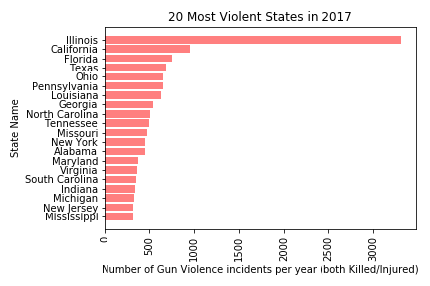
Most Violent States

Slide 10
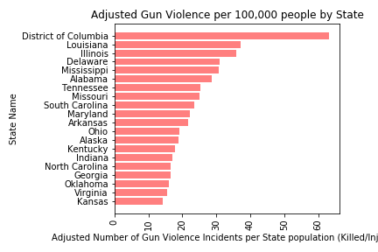
20 Most Violent States compared to 20 Violent States adjusted per 100,000 people.
District of Columbia is categorized as State in the data source.

Slide 11
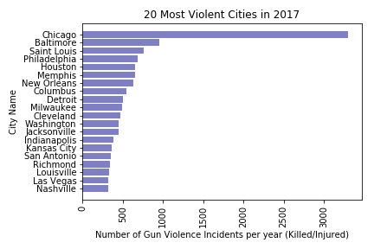
Most Violent Cities

Slide 12
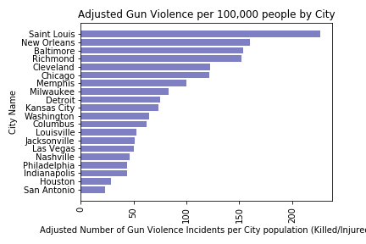
20 Most Violent Cities compared to 20 Violent Cities adjusted per 100,000 people.

Slide 13
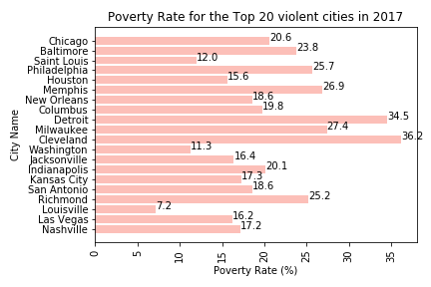
20 Most Violent Cities compared to Poverty Rate for those Cities
Other variables to explore and see if they impact Gun Violence:
Educational Attainment
Divorce Rate
Religion
Age Groups
Mental Illnesses

Slide 14
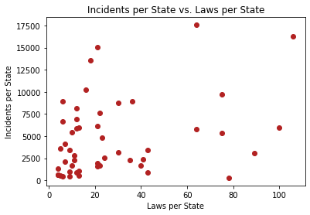
State Legislation and Incidents
Does not seem to be a correlation between total laws in a state and the number of incidents
Further research could look into whether an instance of an individual law had a mean different than the whole (chi-squared test)

Slide 15
Do the number of guns in each state lead to an increase in gun related violence?
Geographically, do areas with higher gun ownership rates correlate to increased occurrences of gun violence?

Slide 16
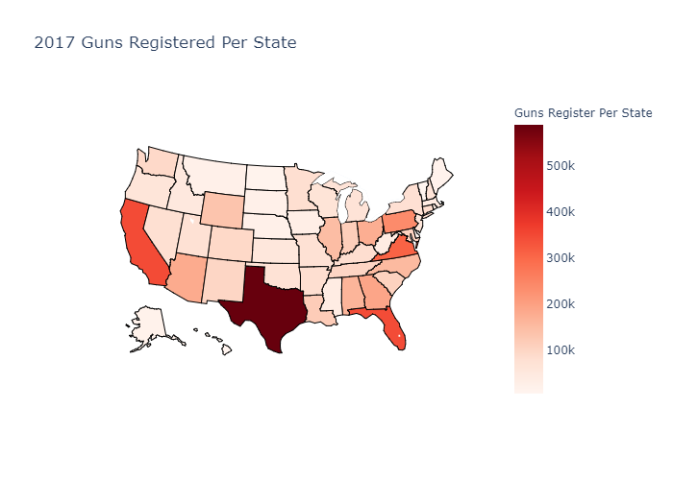
CA, TX, FL, VA and PA have the highest amount of registered guns.
If the amount of guns in state impacts the number of violent related activities, we expect these five states to be the highest in gun violence as well.

Slide 17
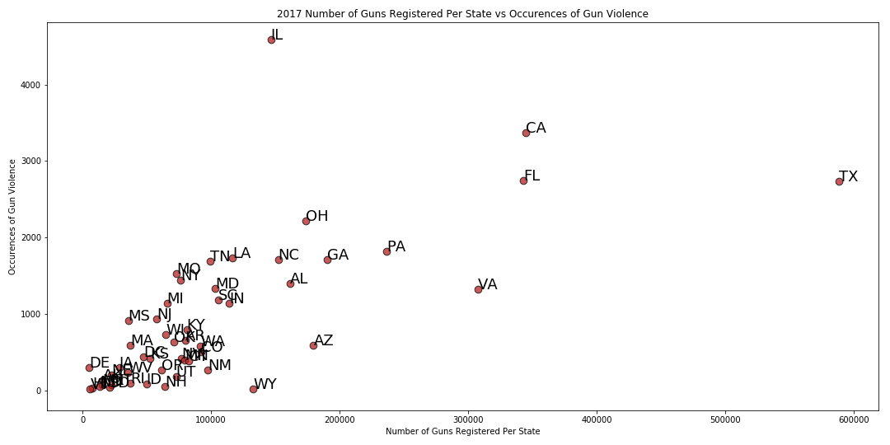
IL is far and away the most violent state
TX, CA, FL do show a higher number of gun related crimes, however VA is lower than numerous states and PA is nearly even with other states.
The number of guns may impact the amount of crime; however these states are also some of the most populated.

Slide 18
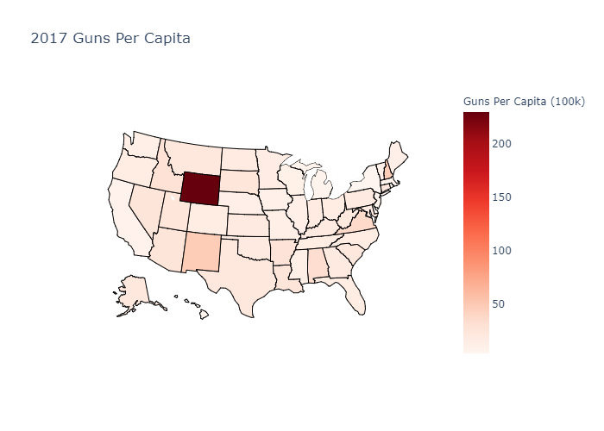
WY far and away has the most guns per capita.
DC, NH, NM, and VA round out the top 5.
If the amount of guns per person impacts the number of violent related activities, we expect these five states to be the highest in gun violence as well.

Slide 19
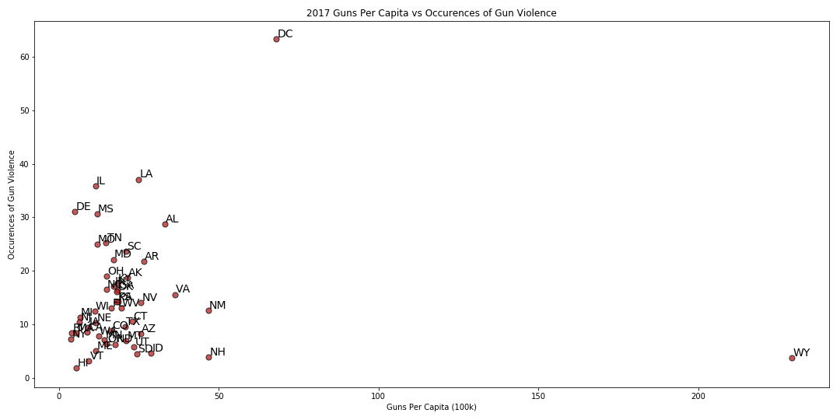
WY far and away has the most guns per capita but has very little gun related crime.
DC has the most crime on a per capita basis, however given the fact it isn’t a state may impact the numbers.
NH, NM, and VA are all significantly lower than various states.
There doesn’t appear to be a conclusive correlation that the number of guns per person is leading to gun related crimes.

Slide 20
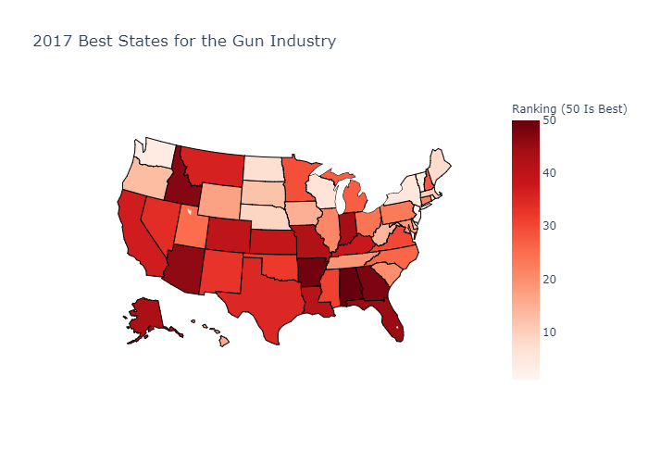
Do states that favor the gun industry have a higher amount of gun related crime?
Rankings By:
Gun jobs
State friendliness to manufacturers
States’ gun cultures
Other factors
State mandated breaks
Right-to-work states
Average wages

Slide 21
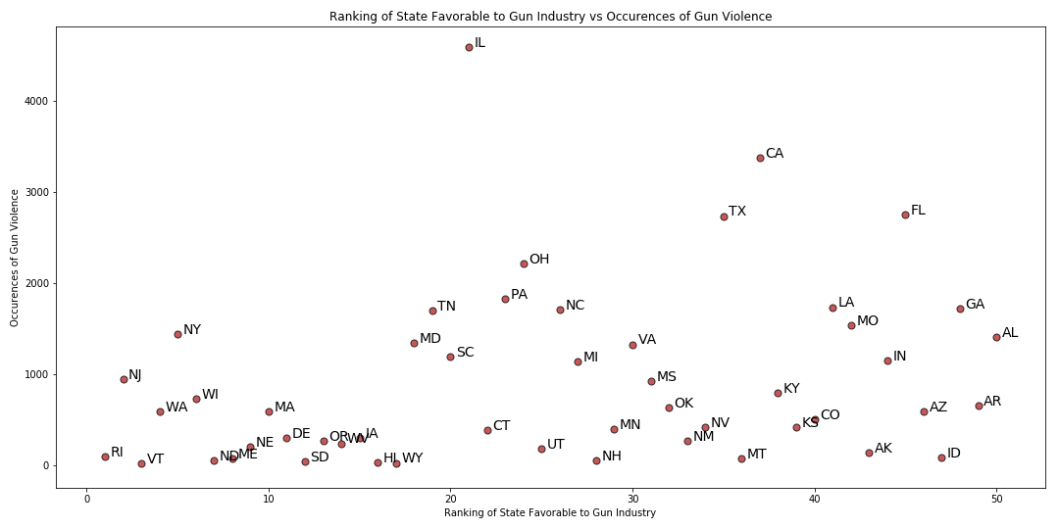
Whether or not a state is more favorable to the gun industry has no impact on the amount of gun related crimes in that state.

Slide 22
Conclusions
Occurrences of gun violence have increased every year from 2014 to 2017
July has shown to be most dangerous month for gun violence
The last year in our data set, 2017, had the highest volume of people injured and killed
Overall, larger States and Cities with larger population have greater levels of Gun Violence.
However, if adjusted per capita, we get a better picture of States and Cities with highest Gun Violence.
Cities with most Gun Violence have little to no correlation with Poverty Levels of those Cities.
Number of laws per state does not seem to correlate with incidents per state
Further research could look at specific laws, or possible confounding variables

Slide 23
Conclusions
Initially the number of guns appears to impact the number of gun related crimes, however when you adjust for population there does not seem to be a correlation between the two.
Further research could examine crimes on a registered gun vs unregistered gun level.
It may indicate that there many responsible gun owner
There is no correlation between gun related crimes and whether a state is favorable to the gun industry or not.

